Slide 1
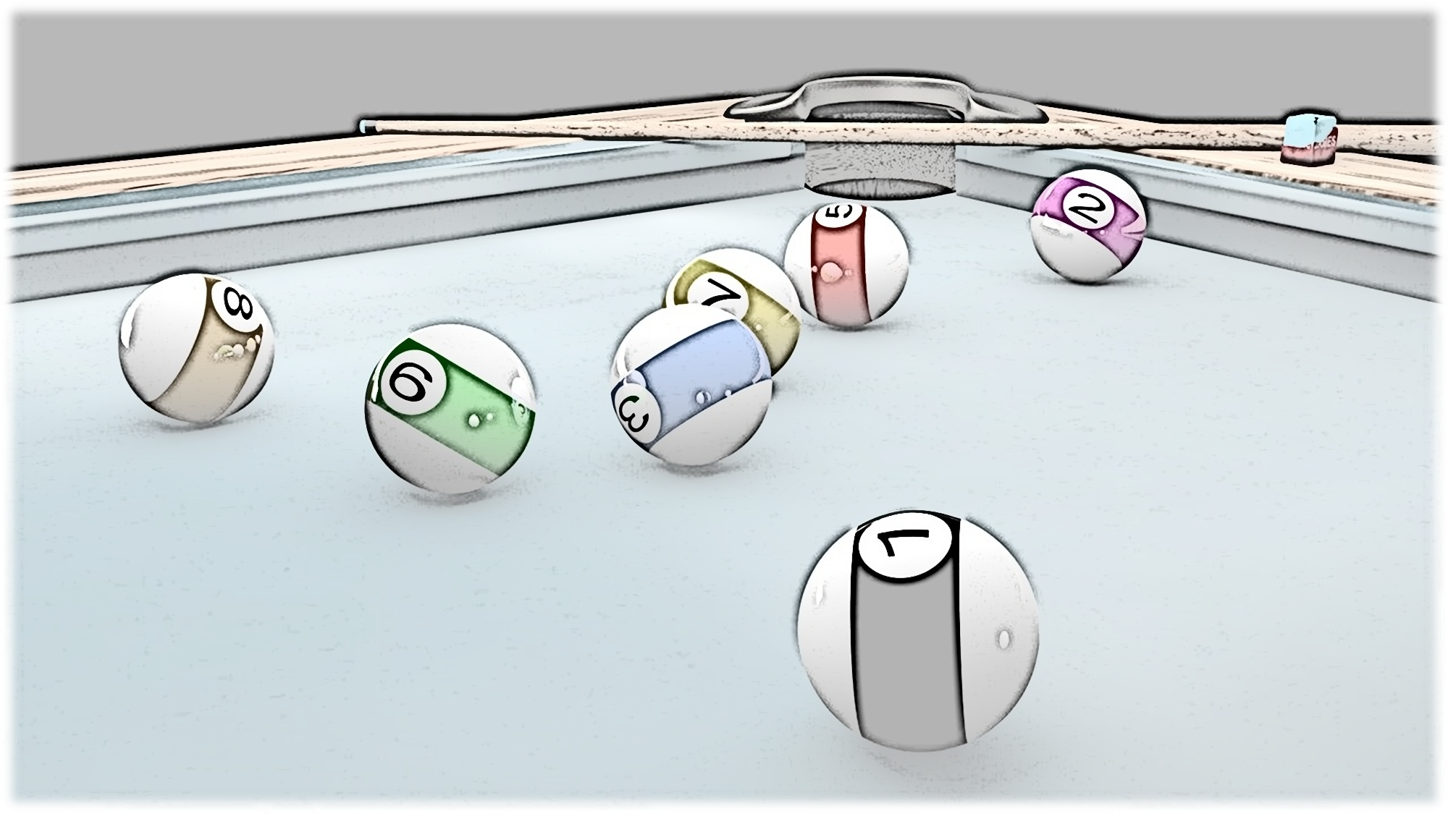
Project : Billiard
AMAHJOUR Walid
AMGHAR Mohamed
CHAROY Léo
TUTORS :
Mr. SALMON Joseph
Mr. CHARLIER Benjamin
2019/2020

Slide 2
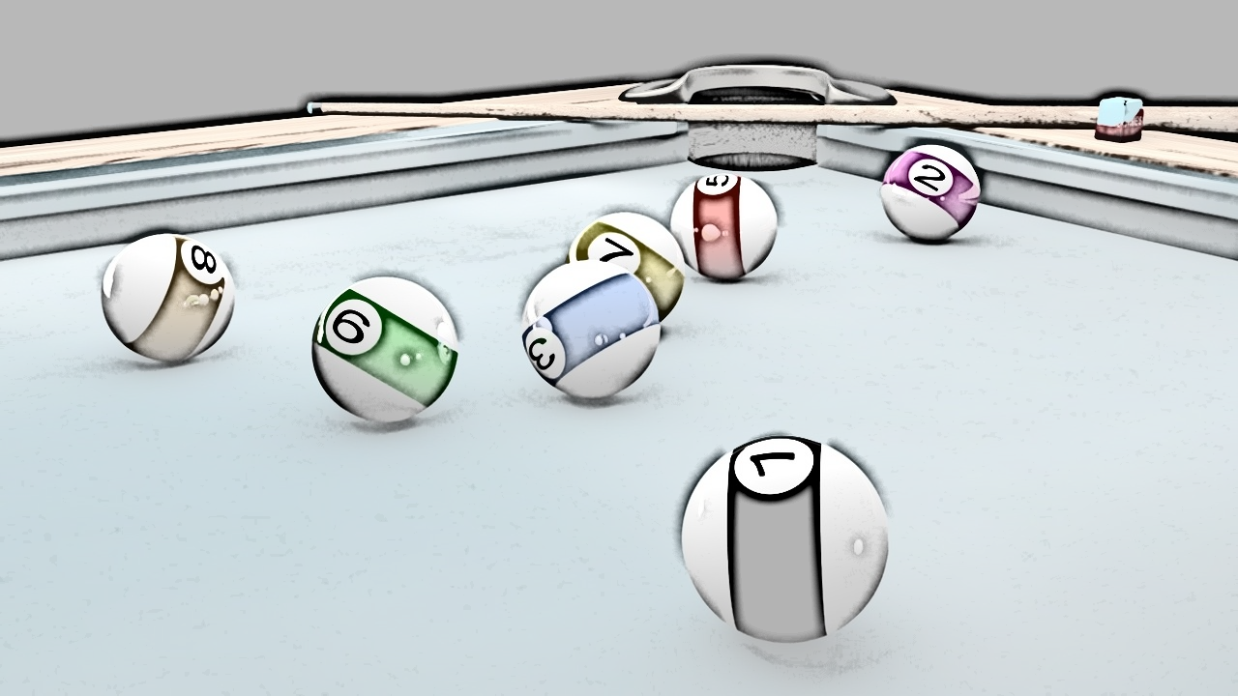
Table of contents : 1. Introduction 2. Square billiard 3. Flat torus billiard 4. Elliptic Billiard

Slide 3
Introduction: Our goal is to produce videos and widget representing a ball in a billiard with a simple shape and showing its trajectory, then we are going to play a name game, and make some simple statistics on the result name.
3

Slide 4
Introduction: In order to achieve our goal we are going to need a multiple packages, most of the have been seen in software development course,and we are gonig to use a tkinter package in order to create a graphical user interface(a GUI),wich handles users inputs and outputs .
4

Slide 5
5
Square case
In order to make the animation we are going to create a graphical user interface with tkinter, where the user inters an angle to begin with, the GUI will contain an entry for the angle, a start button a pause button, a frame for the result name and a green square containing the ball with the following code:

Slide 6
6
Creating a “tkinter” GUI :
root = Tk()
root.title("Billard Simulation")
root.geometry("800x600")
bottomFrame=Frame(root)
bottomFrame.pack(side=BOTTOM)
thelabel=Label(root,text="square case billard simulation")
thelabel.pack()
root.mainloop()

Slide 7
7
Creating the buttons and entry spaces:
def pause(event):
global button
button = False
Pause=Button(bottomFrame,text="Pause",fg="Blue")
Pause.bind(" <Button-1>",pause)
Pause.pack(fill=X)
def Start(event
global button
button = True
restart=Button(bottomFrame,text="Start",fg="Green")
restart.bind("<Button-1>",Start)
restart.pack(fill=X)
label1=Label(root,text="please choose an angle to start with then press enter")#title of the entry
label1.pack()

Slide 8
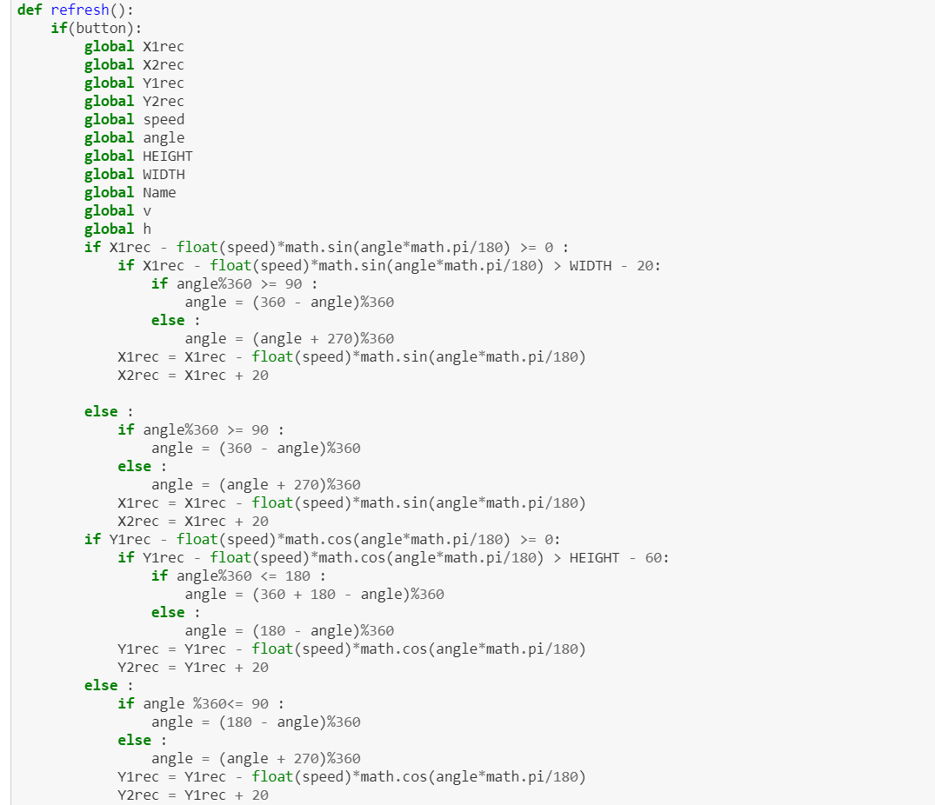
Functions providing animation and
movement conditions:
8

Slide 9
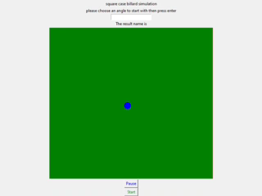

9
Now we present and explain the different step in this video

Slide 10
10
Statistics:
In order to extract more data from our simulation in a less time ,for every angle we are going to need a result word containig 2000 characters, we are going to change the code above, keeping only the movement conditions("refresh" function) and our impact result("evaluateimpact" function), and chaning the angle in the code.

Slide 11
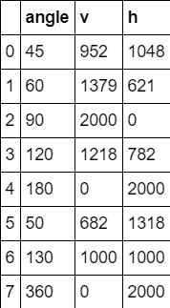
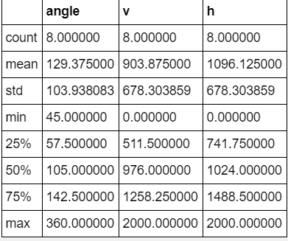
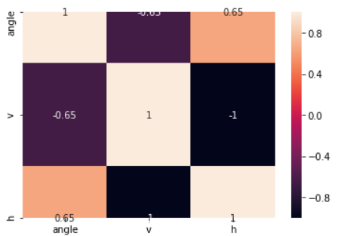
Statistics: after gathering our data we are going to use seaborn library to produce summary table and correlation matrix, and plot the correlation graph.
DATA GATHERED FROM THE SIMULATION
SUMMARY TABLE
CORRELATION MATRIX

Slide 12
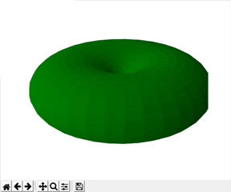
12
Flat Torus Billard
Torus:
In geometry , a torus is a surface of revolution generated by revolving a circle in three-dimensional space about an axis that is coplanar with the circle. Torus representation: the code of the torus plot was found on the internet, we only made some modifications that helped plotting the torus on a TKinter window with "matplotlib.use('TkAgg')" function and adding a toolbar to show all the faces of the torus with .

Slide 13
13
Flat Torus Billard
What is a flat torus?
This is a square whose sides are pair wise identified.
As a consequence, an imaginary being living in this square would exit the upper side each time it enters the lower side and similarly for the left and right sides.

Slide 14
14
Conditions of movement in flat torus case :
With a similar method and a similar functions of the square case billard, we only change the conditions in "refresh" and "evaluateimpact" sort that, if the ball hits one of the borders it appears in the opposite border continuing exactly in the same direction.

Slide 15
Conditions of movement in flat torus case :
if Y1rec - float(speed)*math.cos(angle*math.pi/180) > HEIGHT - 60:
Y1rec = Y1rec - float(speed)*math.cos(angle*math.pi/180)-500
Y2rec = Y1rec + 20
if Y1rec - float(speed)*math.cos(angle*math.pi/180) <=0:
Y1rec = Y1rec - float(speed)*math.cos(angle*math.pi/180)+500
Y2rec = Y1rec + 20
if X1rec - float(speed)*math.sin(angle*math.pi/180) > WIDTH - 20:
X1rec = X1rec - float(speed)*math.sin(angle*math.pi/180)-500
X2rec = X1rec + 20
if X1rec - float(speed)*math.sin(angle*math.pi/180) <=0:
X1rec = X1rec - float(speed)*math.sin(angle*math.pi/180)+500
X2rec = X1rec + 20

Slide 16
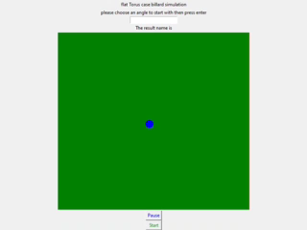
15
Now we present and explain the different step in this video:

Slide 17
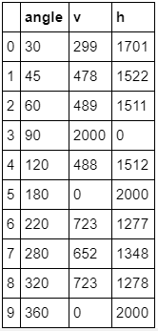
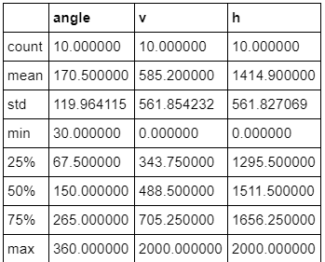
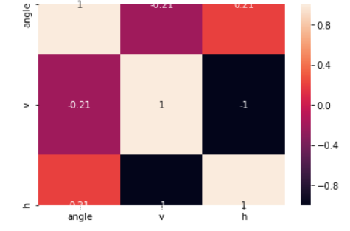
16
Statistics on multiple simulations :

Slide 18
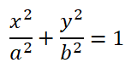
16
Elliptic Billiard
Once again, a ball is set free in a stadium, this time of an elliptic shape. No friction will be taken into account. The analytic equation of such curve, surrounding two focal points,
Is ,with a et b being the width and height.
The billiard variables are the initial ball placement, as well as the angle of the first projection. By resolving some quadratic equations detailed in the github, it is possible to predict, given the initial conditions, every future bounce with the curve

Slide 19
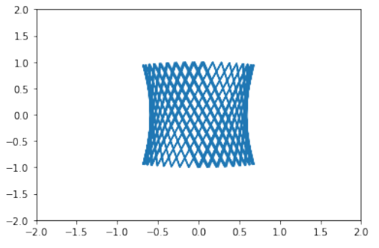
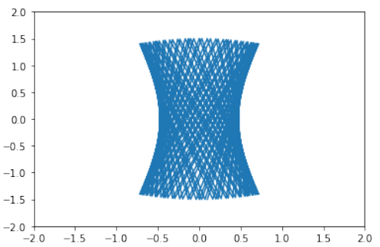
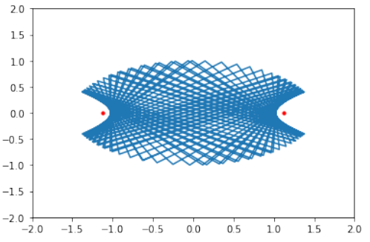
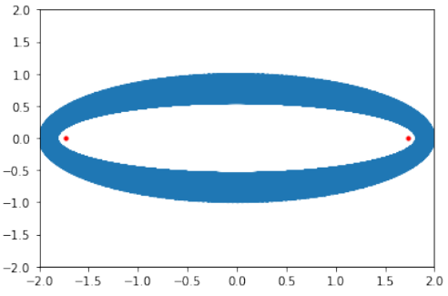
17
The different step to realize an elliptic billiard
On the other hand, considering the vertices of the ellipse, meaning the endpoints of the axis, it is also clear that if the ball first rolls between one focal and one of these vertices, the trajectory will be bound in an annular region bounded by another, smaller ellipse :

Slide 20
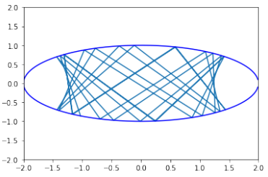
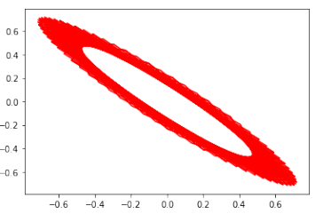
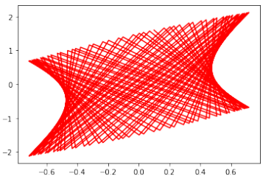
18
By modifying the entry point, these trajectories can occur :

Slide 21
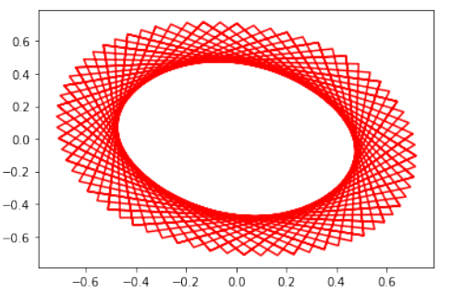
19
One can find multiple interesting shapes by modifying a, b or the initial conditions. Also, observing coordinates relations leads to interesting patterns. For instance, with the same parameters (except 10 times more iterations) as the first figure, plotting following x coordinates brings :

Slide 22
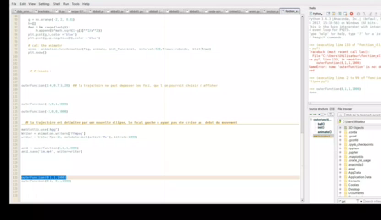
20
A demonstration video with different angle:

Slide 23
21
Obviously, our trajectory is coded by a sequence of values at every bounce, which creates a dynamical and deterministic system. Even if, depending of the ellipse’s shape, the path may be sensible to initial conditions, it remains on a particular curve, and the system can’t be called chaotic. Researches are regularly being made on the periodicity of such systems, given a N number of bounces. We’ll briefly talk about the apparition of chaos, when the initial shape becomes more and more deformed in the presentation.

Slide 24
22
Conclusion
This project allowed us to take a interesting look into the world of dynamical billiards. Using different systems and libraries to code and animate them, we are now equipped to deal with dynamical systems as a whole much more confidently. These systems being linked to many areas of research and applications (chaos, logistic maps), it has clearly been an very useful take and study.
Fore more details: https://github.com/amahjourwalid/projet_billard

Slide 25
23
Sources
Repo for the course HMMA238 'Software Development‘
Tkinter documentation
Matplotlib documentation
Seaborn documentation
https://scipython.com/book/chapter-7-matplotlib/examples/a-torus/

Slide 26
24
Thank you for your attention

